Slide 1
CNMC in 8 Split State
Divesh Aggarwal - NUS
Nico Döttling - CISPA
Jesper Buus Nielsen - AU
Maciej Obremski - NUS
Erick Purwanto - NUS

Slide 2
PLAN
Introduction to NMC
Impossibilities, Learning, Construction
Toy Game
6 Dimensional Synchronous Swimming

Slide 3
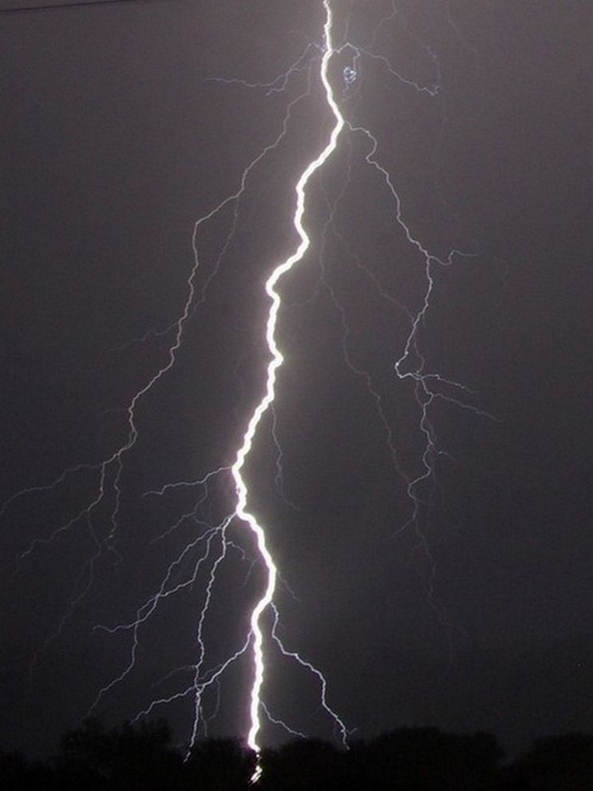
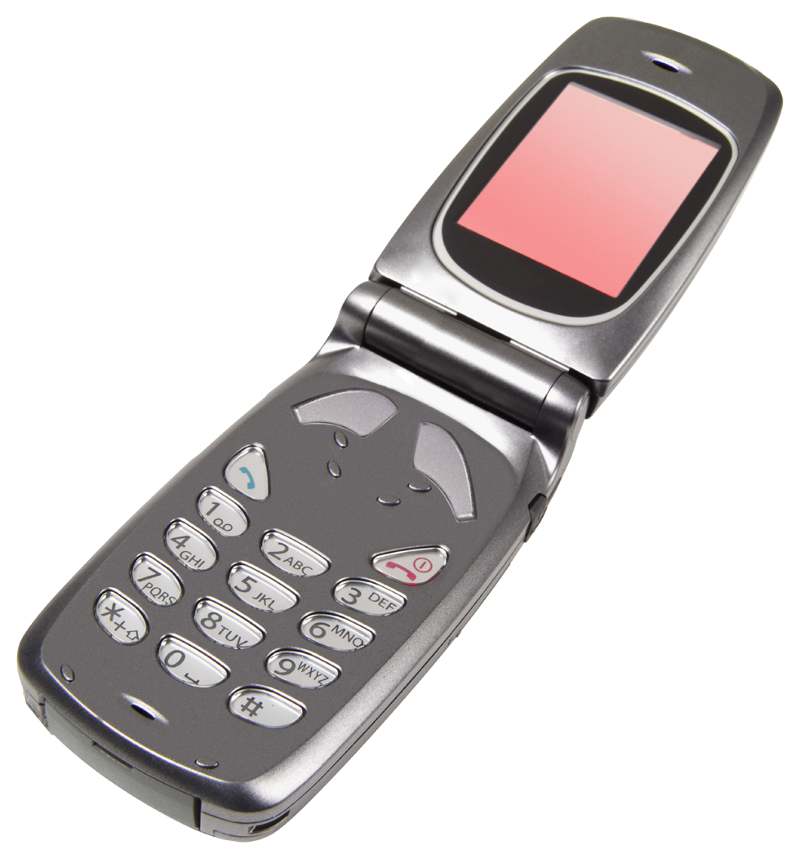
ECC

Slide 4

Beyond Correction
⏊

Slide 5
Can We Extend It Further?
Malicious Error!

Slide 6
Algebraic Manipulation Detection Codes (AMD Codes)
Detection of algebraic manipulation with applications to robust secret sharing and fuzzy extractors.
Cramer, Dodis, Fehr, Padro, and Wichs.
Eurocrypt 2008

Slide 7
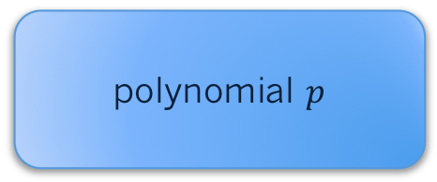
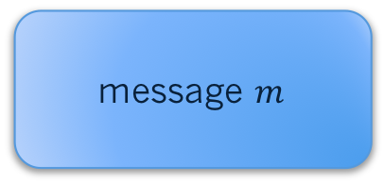

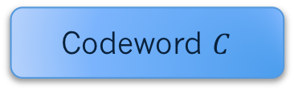
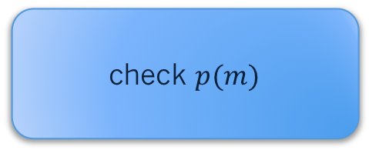
AMD
Offset $V$
⏊
Codeword $C$
message $m$
polynomial $p$
check $p(m)$

Slide 8

This is Very Weak Adversary
Can we make Adversary stronger?
If Adversary can add some offset then maybe lets allow him to
overwrite bits too?
If Adversary can overwrite all bits then we can’t detect it
Overwrite is not particularly
complicated function…

Slide 9
Definition of Non-Malleable Codes
Scheme is non-malleable with respect to family H if
h can be represented as a probabilistic combination
constant functions
identity function

Slide 10
We have to limit class H
can not be represented as combination
of constant functions and identity

Slide 11
Existential Result
Non-Malleable Codes (ICS 2010)
S.Dziembowski, K.Pietrzak and D.Wichs
Existence of codes for small enough manipulation families via probabilistic argument
Where n is a size of codeword

Slide 12
Split State Model
Brief reminder of the model:
Enc(m)= L , R
Manipulation functions (f,g) are any arbitrary functions,
f,g are applied separately to L and R :
f
L
L’
Enc(m)
g
Dec(L’,R’)=m’
R
R’

Slide 13
t-Split State Model

Slide 14
Let’s Try To Build 2 State NMC

Slide 15
Could Secret Sharing Work?
Attack example
function h can not be represented as combination of
identity and constant functions

Slide 16
Could the Inner Product Work?
Attack example

Slide 17
Could Extractors on the Smaller Field Work?
That is still not enough. Attack example:

Slide 18
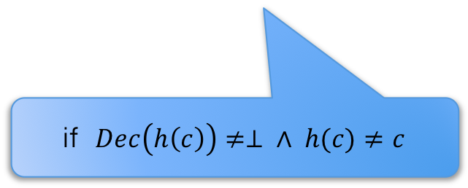

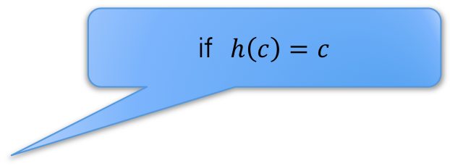

Game Based Definition
Super-Strong Variant
if $h\left(c\right)=c$
*same*
if $Dec\left(h\left(c\right)\right)= ⊥$
NMC
Error
M
$$h(c)$$
Adversary has to guess M
if $Dec\left(h\left(c\right)\right)≠⊥ ∧ h(c)≠c$

Slide 19
Continuous NMC
NMC’
-Same -Error
-Codeword’
NMC
-Same -Error
-Codeword’
*
NMC’
…
-Same -Error
-Codeword’
NMC’
Adversary can continue this until he gets detected i.e. outputs ERROR

Slide 20
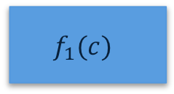
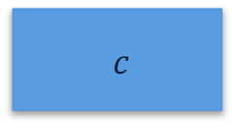

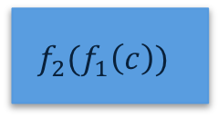
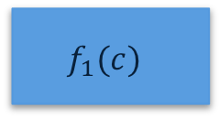
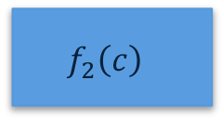
Persistent
$c$
$$f_{1}(c)$$
$$f_{2}(f_{1}\left(c\right))$$
vs Resettable
$c$
$$f_{1}(c)$$
$$f_{2}\left(c\right)$$
Persistent CNMC in 2 split state was given in AKO’17.
It’s much weaker model.

Slide 21
PLAN
Introduction to NMC
Impossibilities, Learning, Construction
Toy Game
6 Dimensional Synchronous Swimming
DONE

Slide 22
CNMC is impossible without Self-destruct, even in Bitwise Tampering Model, even in Persistent setting…

Slide 23
b₁
0
0
0
0
b₂
b₂
b₂
1
b₃
0
b₃
b₃
b₃
b₄
b₄
b₄
b₄
b₅
b₅
b₅
b₅
…
…
…
…
b_{n}
b_{n}
b_{n}
b_{n}
Same*
Same*
not Same*
not Same*

Slide 24
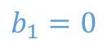
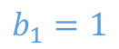
Impossibility in 2 Split-State
L
R
b₁
$$b_{1}=0$$
$$b_{1}=1$$

Slide 25
Small incremental learning beats the scheme

Slide 26
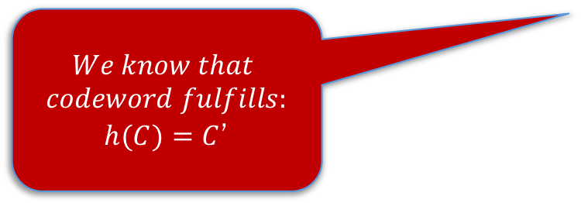
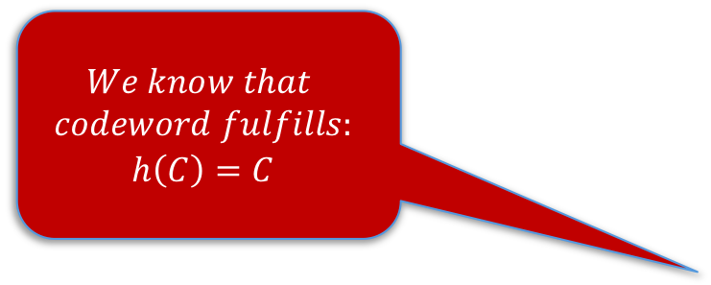
Learning is unavoidable
$$We know that$$
$$codeword fulfills:$$
$$h\left(C\right)=C$$
NMC’
-Same
-Error
-Codeword’
NMC
-Same -Error
-Codeword’
*
NMC’
$$We know that$$
$$codeword fulfills:$$
$h(C)=C$’
…
-Same -Error
-Codeword’
NMC’
New knowledge can spoil independence etc.

Slide 27
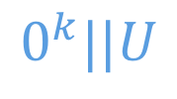
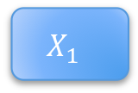
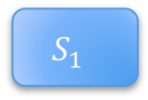
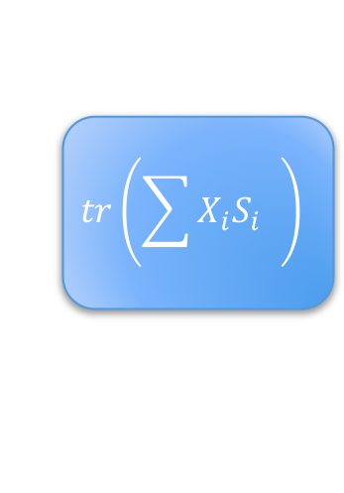
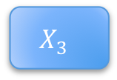
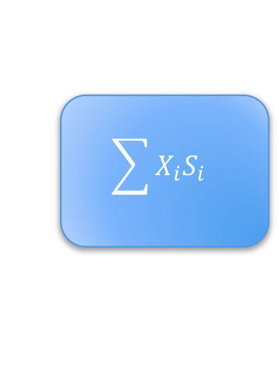
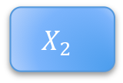

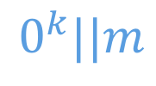

Construction
nmExt
nmExt
$$0^{k}||m$$
$$0^{k}||U$$
$$X_{1}$$
$$X_{2}$$
$$X_{3}$$
$$S_{1}$$
$$S_{2}$$
$$S_{3}$$
$$\sum{X_{i}S_{i}}$$
$$tr\left(\sum{X_{i}S_{i}} \right)$$
this one prevents incremental learning

Slide 28
PLAN
Introduction to NMC
Impossibilities, Learning, Construction
Toy Game
6 Dimensional Synchronous Swimming
DONE
DONE
Notes:
8-9 min even 10 will be fine.

Slide 29
The Game – Toy Version

Slide 30
The Game – Toy Version

Slide 31
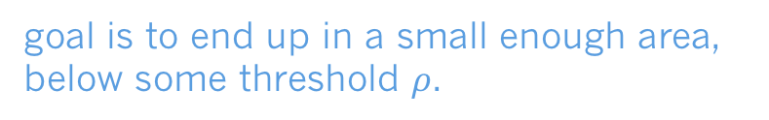
The Game – Toy Version
goal is to end up in a small enough area,
below some threshold $ρ$.

Slide 32
The Game – Toy Version

Slide 33
The Game – Toy Version

Slide 34
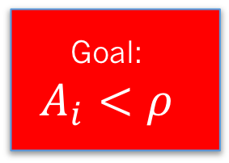
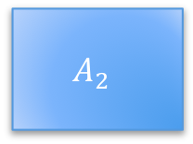
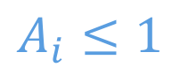




The Game – Toy Version
$$A_{i}≤1$$
$$A_{3}$$
$$A_{1}$$
Goal:
$$A_{i}<ρ$$
$$A_{2}$$
$$A_{5}$$
$$A_{4}$$

Slide 35
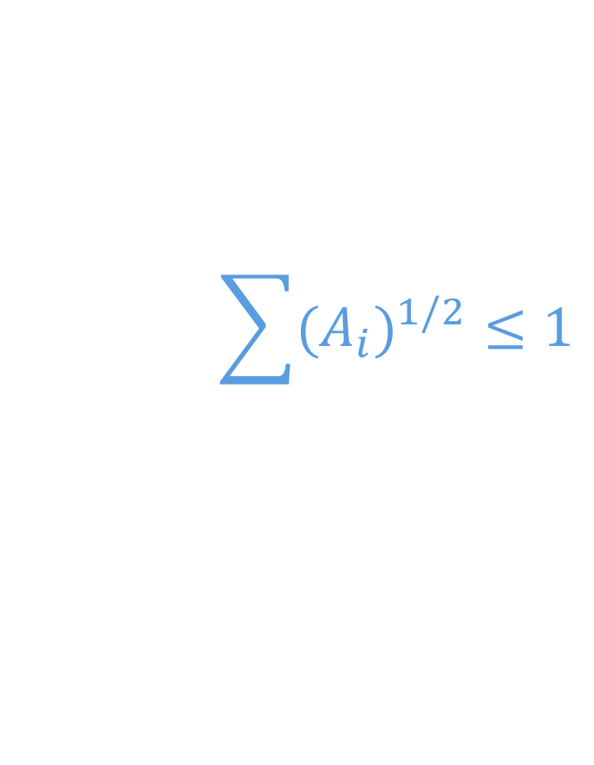
The Game – Toy Version
Key Lemma
$$\sum{{{(A}_{i})}^{1/2}}≤1$$

Slide 36
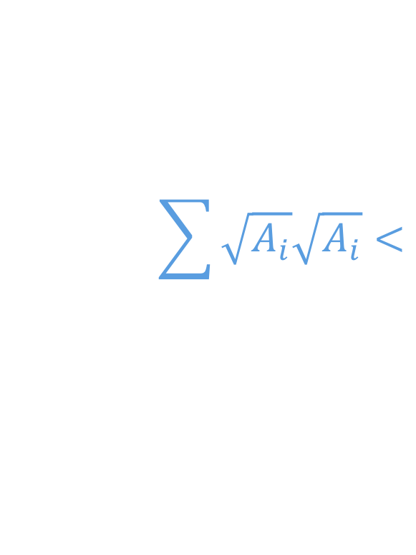
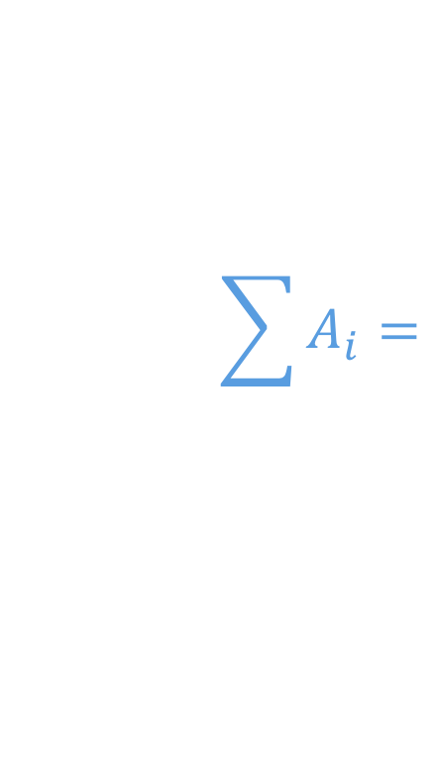
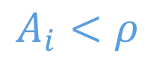
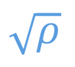
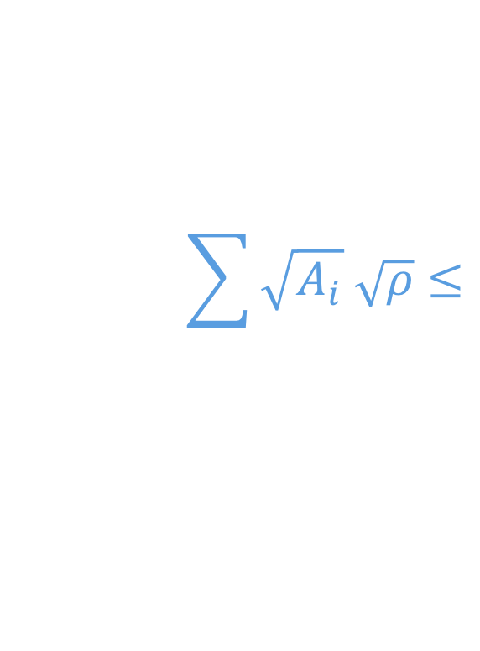
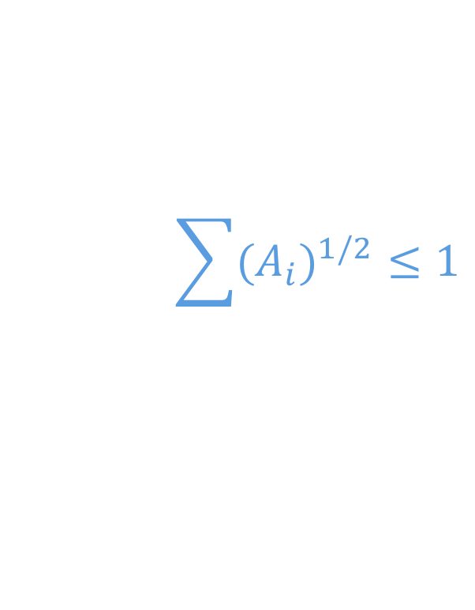
The Game – Toy Version
$$A_{i}<ρ$$
$$\sum{{{(A}_{i})}^{1/2}}≤1$$
Probability of surviving the game
$$\sum{A_{i}}=$$
$$\sum{\sqrt{A_{i}}\sqrt{A_{i}}}<$$
$$\sum{\sqrt{A_{i}} \sqrt{ρ}}≤$$
$$\sqrt{ρ}$$

Slide 37
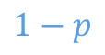
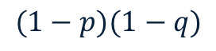

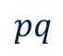
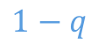
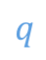
Proof of Key Lemma
$$p$$
$$1−p$$
$$q$$
$$pq$$
$$(1−p)(1−q)$$
$$1−q$$

Slide 38
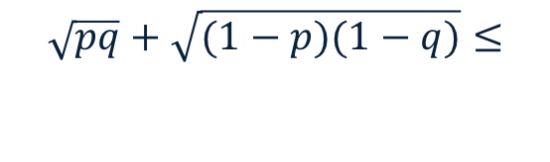
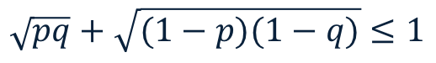
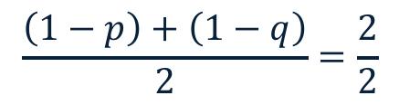
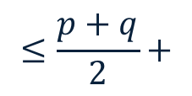
Proof of Key Lemma
$$\sqrt{pq}+\sqrt{(1−p)(1−q)}≤1$$
$$\sqrt{pq}+\sqrt{(1−p)(1−q)}≤$$
$$≤\frac{p+q}{2}+$$
$$\frac{\left(1−p\right)+\left(1−q\right)}{2}=\frac{2}{2}$$

Slide 39
PLAN
Introduction to NMC
Impossibilities, Learning, Construction
Toy Game
6 Dimensional Synchronous Swimming
DONE
DONE
DONE
Notes:
12:40-13:00+

Slide 40
The Game
The real game happens in 6 dimensions
(we show it for any dimension).
Half of dimensions are ‘left’ the other half are ‘right’,
dimensions are ordered in each of the halves.

Slide 41
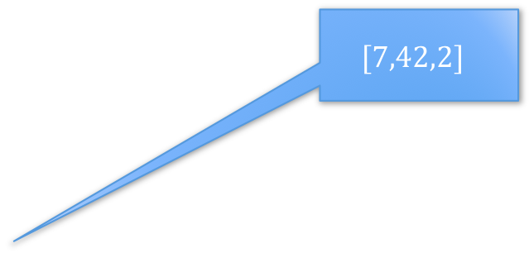
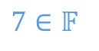
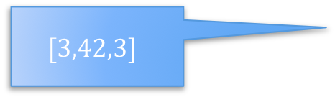
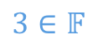
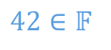


The Game
now each area has a vector associated with it
third dimension
second dimension
$$[7,42,2]$$
$$42∈𝔽$$
$$2∈𝔽$$
$$3∈𝔽$$
first dimension
$$[3,42,3]$$
$$3∈𝔽$$
$$7∈𝔽$$
$$42∈𝔽$$
by the way, all have to be non-zero

Slide 42


The Game
If we do the same for other 3 dimensions then
each cuboid has 2 vectors $v,w∈𝔽^{3}$ assigned to it
Now adversary picks any $c∈𝔽$
and he gets all cuboids such that
$$\left\langle v,w\right\rangle =c$$
If the point falls into his cuboid,
game continues with that cuboid
Goal is to end up in a small enough cuboid

Slide 43

Intermission
The Toy Game is a special case of The Game
We get Toy Game if:
-we restrict The Game to 2 dimensions
-we allow only $\left\{1,−1\right\}∈ℤ_{3}$ as a labels
The Game is not a simple lifting of Toy Game
to higher dimension,
Adv. can own multiple Cuboids in a hyperplane cut!

Slide 44


The Game
Key lemma
$$\sum{{{(A}_{i})}^{5/6}}≤1$$
$$\sum{A_{i}}=\sum{{A_{i}}^{5/6}{A_{i}}^{1/6}}<\sum{{A_{i}}^{5/6}ρ^{1/6}}≤ρ^{1/6}$$

Slide 45

The Game in t-dimensions
$$\sum{{{(A}_{i})}^{(t−1)/t}}≤1$$

Slide 46

Standard Issues
Nothing is really a cuboid, only $ε−$cuboid
We need independence of tampered states
Nothing is really independent, only $ε−$independent

Slide 47
Reduction
Adversary can not learn too much about codeword
Quality (shape) of knowledge matters

Slide 48
Game vs CNMC

Slide 49

Construction
nmExt
nmExt
$$0^{k}||m$$
$$0^{k}||U$$
$$X_{1}$$
$$X_{2}$$
$$X_{3}$$
$$S_{1}$$
$$S_{2}$$
$$S_{3}$$
If, at any point, Adversary applies close to bijective functions to $X_{1},X_{2}, X_{3}$then the codeword won’t be valid w.h.p. (as long as Adversary hasn’t accumulated too much information)
$$\sum{X_{i}S_{i}}$$
$$tr\left(\sum{X_{i}S_{i}} \right)$$
this one prevents incremental learning

Slide 50




Construction
If adversary applies far from bijective tampering then $\sum{X_{i}S_{i}}$ becomes independent of $\sum{{X′}_{i}{S′}_{i}}$
This is Inner Product
nmExt
nmExt
$$0^{k}||m$$
$$0^{k}||U$$
$$X_{}$$
$$X_{1}$$
$$X_{2}$$
$$X_{3}$$
$$S_{1}$$
$$S_{2}$$
$$S_{3}$$
$$S_{}$$
$$\sum{{X′}_{i}{S′}_{i}}$$
$$\sum{X_{i}S_{i}}$$
$$tr\left(\sum{X_{i}S_{i}} \right)$$
this one prevents incremental learning

Slide 51




$$X_{}$$
$$S_{}$$
$${X′}_{}$$
$${S′}_{}$$
$$\sum{{X′}_{i}{S′}_{i}}$$

Slide 52


The Game
Adversary commits to tampering on $X^{′},S′$
If we do the same for other 3 dimensions then
each cuboid has 2 vectors $v,w∈𝔽^{3}$ assigned to it
Adversary h$as to guess$
$$\sum{{X′}_{i}{S′}_{i}}$$
Now adversary picks any $c∈𝔽$
and he gets all cuboids such that
$$\left\langle v,w\right\rangle =c$$
If the point falls into his cuboid,
game continues with that cuboid
Goal is to end up in a small enough cuboid

Slide 53



If Adversary is Correct
$$X_{}$$
$$S_{}$$
$$f$$
$$g$$
$${X′}_{}$$
$${S′}_{}$$
Adversary learns ${X′}_{}$ and ${S′}_{}$, so all he knows is that
$$X∈f^{−1}\left(X^{′}\right)$$
$$S∈g^{−1}(S^{′})$$
$$\sum{{X′}_{i}{S′}_{i}}$$

Slide 54
The Game
Adversary commits to tampering on $X^{′},S′$
If we do the same for other 3 dimensions then
each cuboid has 2 vectors $v,w∈𝔽^{3}$ assigned to it
Adversary h$as to guess$
$$\sum{{X′}_{i}{S′}_{i}}$$
Now adversary picks any $c∈𝔽$
and he gets all cuboids such that
$$\left\langle v,w\right\rangle =c$$
If the point falls into his cuboid,
game continues with that cuboid
Goal is to end up in a small enough cuboid

Slide 55

Bonus – Different Perspective on Games
$$\sum{{{(A}_{i})}^{1/2}}≤1$$
$$\sum{{{(A}_{i})}^{(t−1)/t}}≤1$$

Slide 56




Learning
$$A_{}$$
I learned that point is in $A_{1}$ field
I learned $\log{\frac{1}{ℙ(A)}}$amount of bits
I am surviving the game with
probability $ℙ\left(x∈A\right)=2^{−\log{\frac{1}{ℙ(A)}}}$

Slide 57


The Game – Toy Version different perspective
$$A_{1}$$
I won’t learn much if random point is there
I will learn a lot if random point is here
$$A_{2}$$

Slide 58


The Game – Toy Version different perspective
$$A_{1}$$
We are learning
$$\log{\frac{1}{ℙ(A_{1})}}$$
Avg arguments don’t want to work here
We are learning
$$\log{\frac{1}{ℙ(A_{2})}}$$
$$A_{2}$$

Slide 59









The Game – Toy Version different perspective
$ℙ\left(A_{i} \right| A_{i}∪ D_{i}) \sim 2^{−\log{\frac{1}{ℙ(A_{i})}}}$
$$A_{1}$$
$$D_{1}$$
$$D_{2}$$
$$A_{2}$$
$$D_{4}$$
$$A_{4}$$
$$D_{3}$$
$$A_{3}$$

Slide 60



The Game – Toy Version different perspective
$$ℙ\left(A_{i} \right| A_{i}∪ D_{i}) \sim 2^{−\log{\frac{1}{ℙ(A_{i})}}}$$
Key lemma for Toy Game implies:
$$ℙ\left(A_{i} \right| A_{i}∪ D_{i}) ≤ 2^{− \frac{1}{2}\log{\frac{1}{ℙ(A_{i})}}}$$
General lemma for t-dim Game gives:
$$ℙ\left(A_{i} \right| A_{i}∪ D_{i}) ≤ 2^{− \frac{t−1}{t}\log{\frac{1}{ℙ(A_{i})}}}$$

Slide 61

The Game – Toy Version different perspective
$ℙ\left(A_{i} \right| A_{i}∪ D_{i}) ≤ 2^{− \frac{1}{2}\log{\frac{1}{ℙ\left(A_{i}\right)}}}$
$$ℙ\left(A_{i} \right| A_{i}∪ D_{i}) ≤ {ℙ\left(A_{i}\right)}^{ \frac{1}{2}}$$
$$\frac{ℙ(A_{i})}{ℙ\left(A_{i}\right)+ℙ(D_{i})} ≤ {ℙ\left(A_{i}\right)}^{ \frac{1}{2}}$$
$${ℙ\left(A_{i}\right)}^{ \frac{1}{2}}≤ℙ\left(A_{i}\right)+ℙ(D_{i})$$

Slide 62


The Game – Toy Version different perspective
$${ℙ\left(A_{i}\right)}^{ \frac{1}{2}}=ℙ\left(A_{i}\right)+ℙ(D_{i})$$
$$\sum{ℙ\left(A_{i}\right)+ℙ(D_{i}) }≤1$$

Slide 63
Thank you!

